Slide 1
Signal generation sampling, aliasing, reconstruction
Lab sessions 2

Slide 2
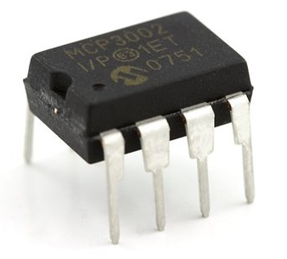
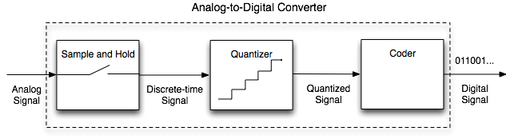
Digital signals
Why digital signals?
Limited memory, bandwidth (to save or transmit data)
Efficient coding (error correcting codes, encryption)
Fast data processing
A/D converter

Slide 3
A/D converter
Today!
Continuous Signal
sampling
N bits → K=2^{N} quantization levels
^{(Example N=3 bits code)}
000 001
010 011
100 101
110 111
quantization
coding

Slide 4
Sampling: Fourier transform view
x(t)
Continuous bandlimited Signal
X(f)
Fourier
transform
-B
B
xd(n)
Xd(f)
fs
aliases
T= 1/fs
-B
B

Slide 5
Sampling: Fourier transform view
Xd(f)
fs=2B
-B
B
fs>2B
-B
B
fs<2B
-B
B

Slide 6
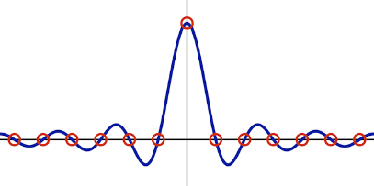
Reconstruction using “ideal low pass filter”
Xd(f)
Xr(f)=Xd(f)H(f)
-B
B
-fs/2
fs/2
f
-B
B
f
Ideal H(f)=rect(f/fs) filter
xd(t)
h(t)=sinc(t/T)
T= 1/fs
t

Slide 7
Nyquist rate: a fundamental limit
Xd(f)
fs=2B
-B
B
fs>2B
Perfect reconstruction when
fs>= 2B (Nyquist rate)
ideal filter used
-B
B
fs<2B
-B
B

Slide 8
Reconstruction filter = interpolation!
Example: Reconstruction by Linear interpolation
h(t)
reconstruction filter
-T
T
t
xd(t)
T= 1/fs
c
c
t
t

Slide 9
Reminder
Course evaluation:
Presence 5%
Lab sessions 25%
Completion of the session
Understanding of the session
Appropriate write up in the Lab book
Assignment1 35%
Assignment2 35%
Contact: mike.davies@ed.ac.uk

